Slide 1
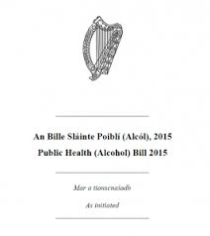
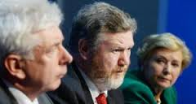
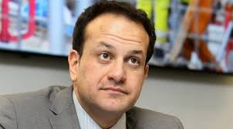
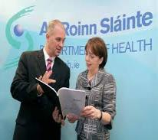
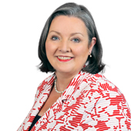
HSE Alcohol Programme

Slide 2
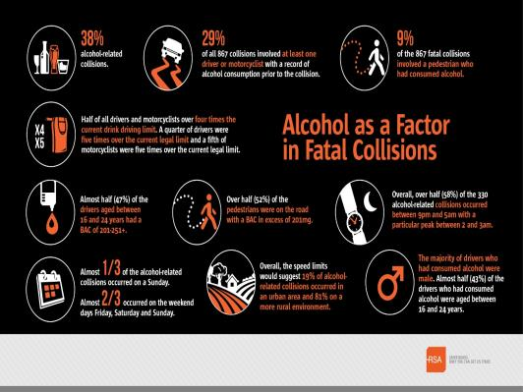
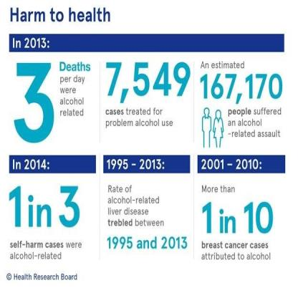
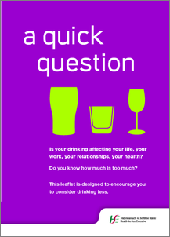

Slide 3
Reduce alcohol consumption to reduce harm
Target is to reduce consumption to 9.1 litres per capita by 2020 in order to reduce alcohol related harms.
Key measures in the Public Health Alcohol Bill – minimum unit price, statutory regulation of advertising and promotion of alcohol brands including sponsorship and reducing the availability of alcohol will all help reduce the supply of alcohol.
Measuring the individual and societal harms is critical to build understanding of the problem and support for public health approach to reducing harm.
Providing support and treatment to individuals and family members negatively impacted by alcohol is critical.
Benefits of reducing alcohol consumption are significant for drinker and non-drinker alike.

Slide 4
Primary areas of activity from 2017
Screening and Brief Intervention: SAOR, MECC Making Every Contact Count, online self-assessment tools.
External Communications Campaign on Alcohol Risk ; a website, digital campaign, and print resources in the first phase 2017.
Accompanying internal campaign on alcohol risk
Data collection and analysis to measure the impact of alcohol harm on the health services.
To work with colleagues to improve access to treatment services for people with alcohol related problems.
To establish a special interest group on FASD

Slide 5
HSE Alcohol Programme Activity
HSE Alcohol Programme Implementation Group: members from a range of HSE divisions including public health, communications, NOSP, addiction services, knowledge management, acute hospitals, mental health, human resources, Healthy Ireland and policy expertise.
Subgroups on: Data, Communications and Screening and Brief Intervention and a special interest group on FASD.
HSE Alcohol Programme External Stakeholders Group.
HSE Alcohol Programme Implementation Plan 2017-2020 will be completed by the end of the year.

Slide 6
THANK YOU
PLEASE DON’T HESITATE TO CONTACT US
Suzanne Costello suzanne.costello1@hse.ie
(Tue – Thu) 087 647 0552
Marion Rackard marion.rackard@hse.ie
(Mon – Thu) 087 419 3371

