Slide 1
Problem alcohol use in the Irish population: review of current data
Suzi Lyons
Deirdre Mongan
Jean Long

Slide 2
Patterns of drinking

Slide 3
Alcohol consumption in Ireland
In 2014 alcohol consumption per adult was 11 litres

Slide 4
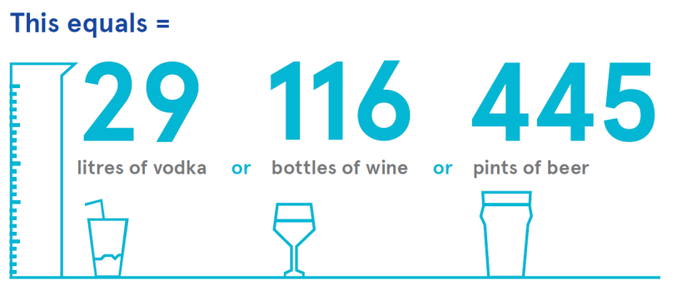

Slide 5
Alcohol consumption in Ireland
In 2014 alcohol consumption per adult (15 yrs+) was 11 litres
29 litres of vodka, or 116 bottles of wine, or 445 pints of beer
Beer accounted for 47%, wine 27%, spirits 18%, cider 7%
In 2012 Ireland had the fourth highest alcohol consumption level among 36 OECD countries

Slide 6
Alcohol consumption 1984-2014

Slide 7
Alcohol consumption 1984-2014

Slide 8
National Alcohol Diary Survey 2013

Slide 9
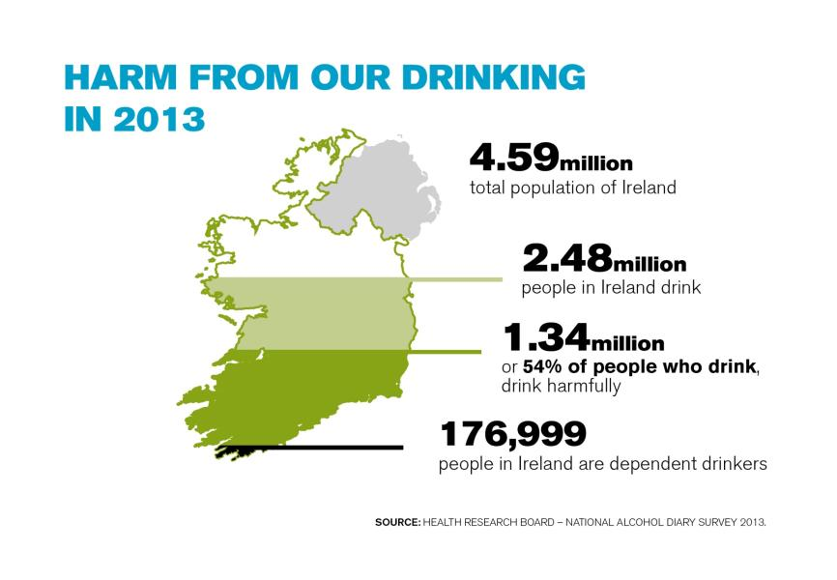

Slide 10
National Alcohol Diary Survey 2013
Harmful drinking patterns the norm in Ireland
At least 75% of all alcohol consumed as part of a binge drinking session
54% classified as harmful drinkers using World Health Organization AUDIT-C
7% classified as dependent drinkers
Those aged 18-24 years most likely to have a harmful drinking pattern

Slide 11
Alcohol-related harm

Slide 12
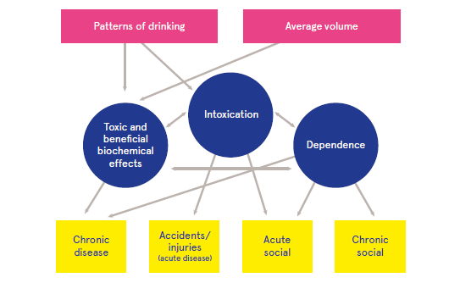
Alcohol consumption, harm and consequences
Source Mongan and Long 2016
Notes:
Harm is a word that is used frequently when talking about alcohol so it is worthwhile to take a minute just consider what it means:
Harm from alcohol is directly related to the amount drunk, pattern of drinking and the duration of drinking.
It is both social and physical and can be both chronic or acute

Slide 13
Alcohol treatment data
Notes:
Why are we interested in alcohol treatment data?
Many people consume alcohol and may never have a problem.
However when people start to experience the negative or harmful effects of drugs and alcohol – missing work, withdrawals, losing friends etc, then many will turn up in treatment data.
Therefore treatment data is one way of counting the more acute and serious HARM and damage done by problem alcohol use. It also helps us to plan our services.
The data on treatment comes from the National Drug Treatment Reporting System. It counts any one who enters treatment in the particular year.

Slide 14
National trends in treated problem alcohol and other drug use, NDTRS 2008 to 2014
Notes:
What we will see in the next slide is that there is often a long time between when people start to drink and when they present for treatment so it is likely that the impact of, for example, the peak in per capita consumption in 2001 may yet to have an impact on treatment demand.
The next slide looks at the characteristics of those in treatment

Slide 15
National: Characteristics of cases treated for problem alcohol use, NDTRS 2014 (preliminary)
Median age in treatment
40 (20 to 63)
Median age first
used alcohol
16 (12 to 22)
Notes:
6 out of 10 are men
Half had started drinking at the age of 16 years [legal age is 16]
But 40 was the average age for those in treatment.
Another very important statistic is that 6 out of 10 of those in treatment were already classified as dependent (donut shape). This means that they are harder to treat and it is harder to get them into recovery. What we want is more people to seek treatment before they become dependent
High levels of unemployment - Only 22% (I in 5) were employed. As 60% were already dependent drinkers is this a representation of the harmful and negative consequences of drinking – losing your job and not being able to hold down a job. The National Alcohol Diary survey estimated that over 5,000 people had lost their job due to alcohol.
6% were homeless.
14% were early school leavers – left before age of 15. And this can be an indicator of deprivation

Slide 16
Alcohol-related hospitalisation

Slide 17
Alcohol-related hospitalisations
Number of hospital discharges with a totally attributable alcohol condition rose by 82% between 1995 and 2013, from 9,420 to 17,120
The mean length of stay increased from 6 days in 1995 to 10 days in 2013, which suggests that patients with alcohol-related diagnoses are becoming more complex in terms of their illness
The number of people discharged whose condition was partially attributed to alcohol increased from 52,491 in 2007 to 57,110 in 2011.

Slide 18
Alcoholic liver disease
Threefold increase between 1995 and 2013

Slide 19
Cost of alcohol-related hospitalisations
In 2013, totally attributable alcohol-related discharges accounted for 3.6% of all bed days that year; compared to 1.7% of bed days in 1995
Total cost of all alcohol-related discharges in 2012 was €1.5 billion - 11% of all public healthcare expenditure
Excludes the cost associated with emergency department cases, GP visits, psychiatric admissions and alcohol treatment services

Slide 20
Alcohol-related mortality

Slide 21
Alcohol-related mortality
In 2013, there were 1,055 alcohol-related deaths, which is an average of 88 deaths per month or 3 deaths per day
73% were aged under 65 years
From 2008–2013, medical causes accounted for 69% of alcohol-related deaths, poisonings accounted for 16% and traumatic causes for 15%
People aged under 35 years were most likely to have a poisoning or trauma cause of death while older people were more likely to die from medical causes

Slide 22
Poisoning deaths: main drugs in 2014

Slide 23
Conclusion
Alcohol consumption in Ireland is high and harmful drinking patterns are common
National data can measure the harm of problem alcohol use
Burden on health services
Financial costs to society
Burden on people of working age
Many evidence based policy and public health interventions can help to reduce the harm of problem alcohol use

Slide 25
Alcohol and the workplace
Unemployed people twice as likely as employed people to be alcohol dependent
Among those unemployed, 1.4% reported they lost their job as a result of their alcohol consumption; this equates to 5,315 people on the Live Register
4.2% of those employed missed days from work due to their alcohol use in the 12 months prior to the survey
The estimated cost of alcohol-related absenteeism was €41,290,805 in 2013

Slide 26
http://www.drugsandalcohol.ie/25697/

