Slide 1


www.galwayalcoholstrategy.ie

Slide 2
Galway City Alcohol Forum
An Garda Siochana
NUIG Health Promotion
Galway City Community Forum
Elected representative (Councillor)
Galway City Council
HSE Addiction, Public Health, Health Promotion
Western Region Drugs Task Force
Galway/Roscommon Education & Training Board

Slide 3
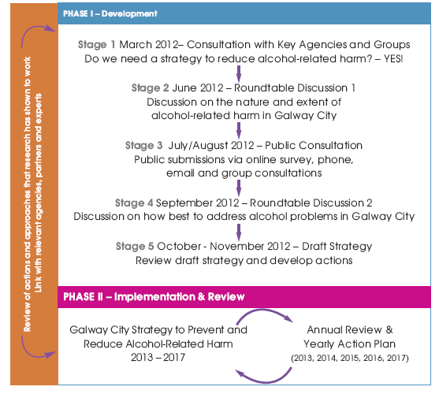
Process

Slide 4
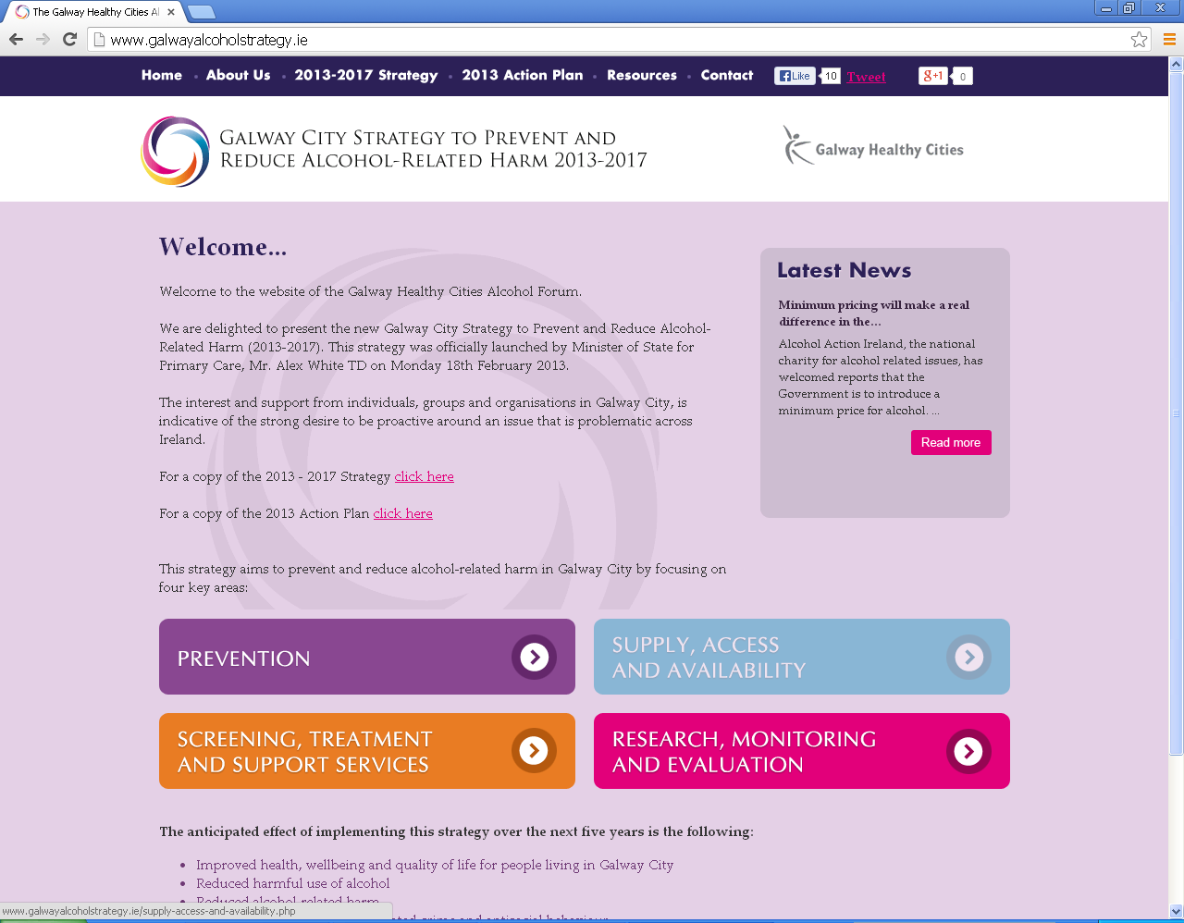
www.galwayalcoholstrategy.ie
Notes:
371 unique visitors to website

Slide 5
Notes:
24 local media articles and radio interviews generated by Galway Healthy Cities Alcohol Forum

Slide 6

Alcohol Availability
Notes:
Map of number, type and density of outlets selling alcohol in Galway City completed
Licensing renewal system investigated and communicated through Galway Community Forum

Slide 7


Joint Policing Committee
Notes:
164 Oireachtas Members
Motion passed by JPC and Galway City Council on Minimum Pricing July 2013)
Connected with National organisations – Ballymun, HSE, Royal College of Physicians, NUIG, TCD

Slide 8



Notes:
Weekly logs compiled on alcohol advertisements in the local media in general, and on social media of local pubs, clubs and festivals

Slide 9



Notes:
Restricted opening hours of licensed premises on St. Patrick’s Day 2013 with 25% decrease in public order offences

Slide 10
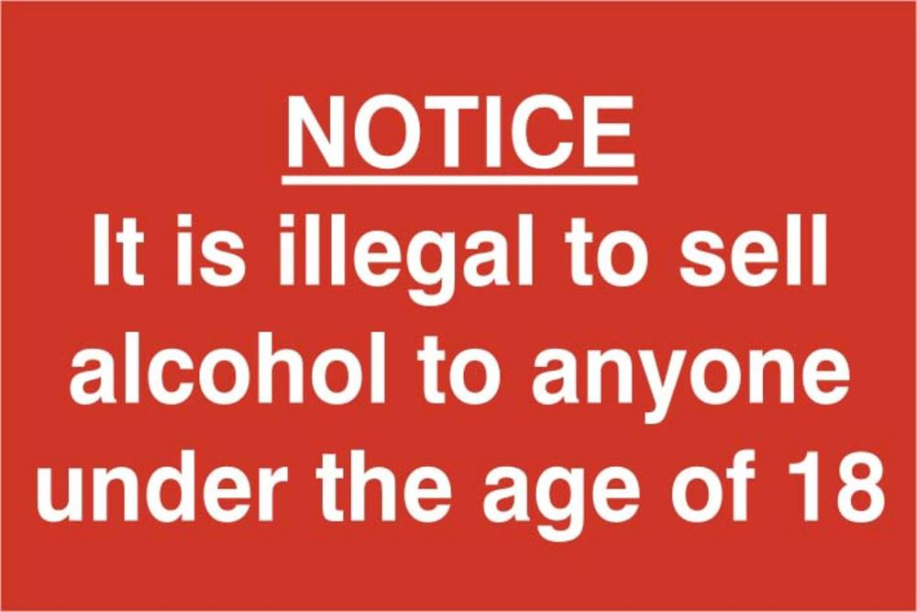
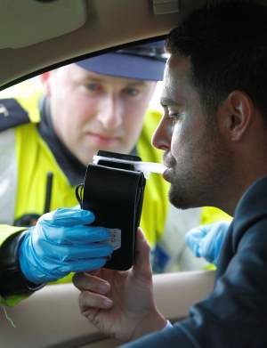
Enforcement is key
Notes:
10 underage test purchases completed with 10 number of prosecutions
135 number of drink driving convictions

Slide 11
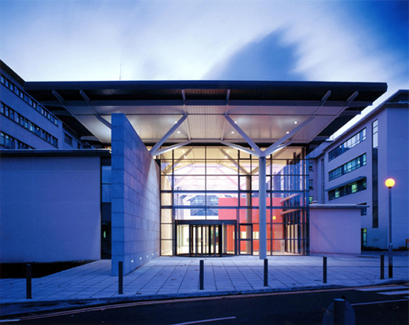
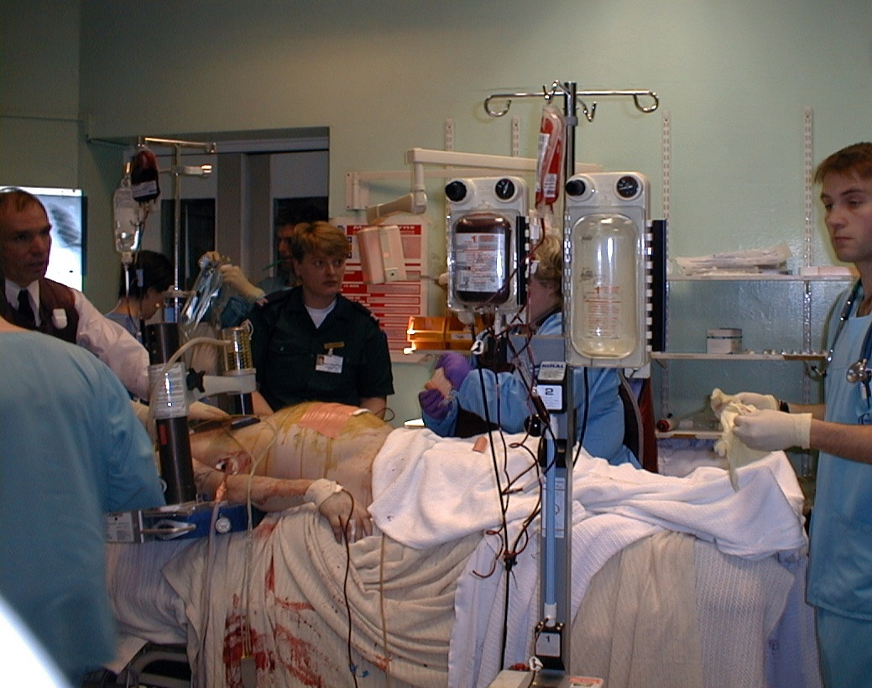
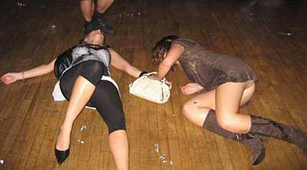
Notes:
2012 HIPE data shows that harmful use of alcohol impacted on University Hospital Galway at a cost of €4.1 million, including 4,784 bed days
Working on securing funding for an Alcohol Liaison Nurse for UHG

Slide 12
Notes:
Compiled list of all available options for alcohol treatment in Galway City
Compiled list of information on services for young people affected by alcohol

Slide 13


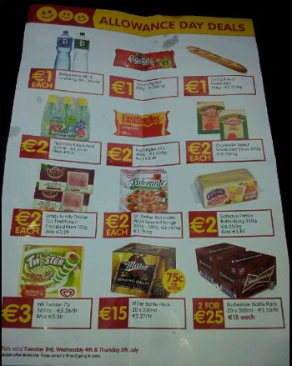




Notes:
Linked to European pilot project to monitor the exposure of young people to alcohol marketing in Galway City. To be completed in 2014.
Linking with NUG on Alcohol and Social norms project and establishment of alcohol research interest group

Slide 14
Action Plan 2014….
PREVENTION
SUPPLY, ACCESS & AVAILABILITY
SCREENING, TREATMENT & SUPPORT SERVICES
RESEARCH, MONITORING &
EVALUTION

