Slide 1

Promoting Community Engagement in addressing Alcohol Issues.
“Community action seeks to change collective rather than individual behaviour”
Notes:
The AF has concentrated on ‘Promoting Community engagement in addressing Alcohol issues, for several years. This focus included a multi-agency pilot project funded by Interreg IVA. The Time IVA Change Border Region Alcohol Project ran from Dec 2009 to June 2012 and the learning from this pilot informed the Community Action on Alcohol Approach.
“Community action seeks to change collective rather than individual behaviour” which impacts on our environment, it is a universal approach
Because Measures that influence the environment are often more effective than those that target the individual drinker
The Alcohol Forum was established in 2007 and is a registered charity that works to reduce alcohol consumption in communities across Ireland.
Our Vision:“A Safe, Responsible & Informed Society in which everyone acts to Protect all generations from alcohol related harms”
Our Mission:“To develop an All-Island Approach to Community Action on Alcohol”

Slide 2


What is Community Mobilisation?
Parents
Youth
Education Sector
Voluntary / Community sector
Businesses
Law enforcement
Government
Drugs & Alcohol Taskforces
Vintners
Politicians
Media
Health Service
Mobilising Community Action on Alcohol is a comprehensive response to an issue, involving
a wide range
of individuals,
agencies and organisations
that come together
when an issue is
too big
for one sector to tackle alone.
Google Images
Notes:
Mobilising the Community to Action on Alcohol works through the Community Development model under the guiding principles of consultation, equality, inclusion and participation, it works from the ground up, to support and raise the capacity of within the community, but also from the top down by acting as a conduit and harvesting the supports that already exist from other agencies but may not be utilised by that community to address local Alcohol issues.
Mobilising the Community to Action on Alcohol is concerned with geographically defined communities.
A multi level approach, guided by what the evidence says works and is planned in response to local need.
An all out agreement to work to a plan over a set period of time and evaluate the outcome

Slide 3
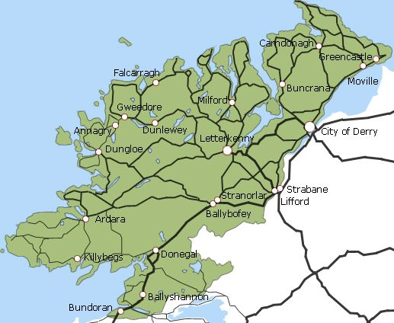

Community Action on Alcohol Pilot Sites Footprint Donegal - 2012
Current Sites South:
Moville (Original Pilot)
Castlefin (2010)
Raphoe (2010)
Donegal Town (2010)
Dunfanaghy (2010)
Mevagh (2011)
Gweedore (2011)
Buncrana (2012)
SW Donegal (2011)
Mohill Co. Leitrim (2012)
Donegal Travellers Project (2011)
Sites North:
Strabane
Limavady
Omagh
Fintona
Castlederg
Fermanagh
Notes:
Mobilising the Community to Action on Alcohol effectively anchors and maximises this work by actively involving local groups and exploiting existing networks.
When we support a community to identify its own concerns and then find ways to address those concerns we create a sense of ownership of the work on the ground that is vital to sustaining such interventions on an ongoing basis.
The Community Development ethos allows us to work hand in glove with local C&V groups.
This slide shows the footprint of the original pilot project, the Time IV A Change Border Region Alcohol project Dec 2009 to June 2012. On the map here each ‘smiley face’ indicates a mobilisation site with local Steering group. Each one had identified their own needs and developed an action plan to address those needs. While the AF developed the resources and tools to support them to do that.

Slide 4
How does it work?
Key Local
Group
C &V Sector
HSE
Local Government
Education
Vintners
Families
Notes:
It has become clear that each area mobilising to Action on Alcohol, needs at least one local key organisation that is prepared to adopt Community Action on Alcohol, into their programme of work. This organisation needs to be rooted in the community network and have the capacity to host and co-ordinate efforts on the ground. This provides the basic local framework to link into.
The pilot project basically ‘piggy backed’ on the existing networks of these local organisations.
It is vital to promoting community action on Alcohol that parity of esteem exists and is fostered between those organisations involved.

Slide 5
Mobilising Community Action on Alcohol:
Introduction
Mobilising Community Action on Alcohol
Community Action on Alcohol
Toolkit
Training
Set up local steering Group
Community Consultation on Alcohol
Focus Groups
Develop Action Plan
Implement
Acton Plan
Gather Feedback
Evaluate
Analyse Findings,
Decide goals,
& Key performance indicators
Service Level Agreement
Alcohol Forum supports:
Alcohol Forum Resources & Training
Notes:
To get started, we need to introduce the concept of Community Action on Alcohol to the local organisations with a vested interest.
The Community Action on Alcohol Toolkit, developed by the AF is based on the learning from the Pilot project and is aligned with current National policy. This is a step by step guide on Community Action on Alcohol supported by training.
A local Steering Group both anchors the work in the community and supports community ownership of the process ....
Community Consultation on Alcohol is a method of detecting how big the problem is and where the “hot” spots are in the community.
This helps scan the community for the existing influences that “assist” in creating alcohol related problems.
It helps to establish the size and shape of the problem, and where to focus efforts for the most impact.
Consultation can also reveals how the community may be unwittingly contributing to the problem.
.......

Slide 6



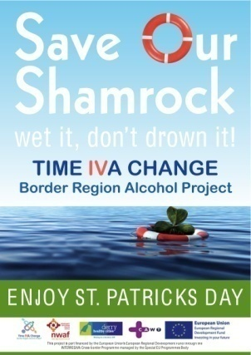



Research
6 mobilisation sites fed into the HSE / Alcohol Forum Hidden Realities Report
Seasonal Campaigns:
Notes:
The needs identified by communities during the pilot and since then has led to the development of a wide variety of specific products. This resource development continues...
To be effective resources need to actively involve people either by pairing with a seminar, training event or social structure. As new areas of concern are raised the AF continues to develop the resources to support communities to address these issues.
That in a nutshell is a very swift run through Community Action on Alcohol, Further information is available on www.alcoholforum.org
Moville Family Conversation:
Spirit of Sport:
Streetwise 4 Life:
Responsible Server of Alcohol Training:
The Responsible Servers Programme is aimed at assisting licence holders and their staff to develop an understanding of policies and procedures around the responsible serving of alcohol. The training will help your staff deal with difficult situations and raise awareness of the legal obligations surrounding the serving of alcohol. Awareness raising, the Law regarding sale & supply of alcohol, skills development; how to talk about harmful drinking, how to develop & implement a club alcohol policy
Festival Care:
The 'Festival Care' guide aims to assist festival organisers or promoters to address the possible negative consequences that can arise from alcohol misuse by offering guidance on the management of alcohol and its related harms at events and providing a communication plan for events that focuses on issues such as personal safety and information for parents.

Slide 7
National Alcohol Awareness Week
31st March to 4th April 2014
‘Alcohol’s Harm to Others’,
‘When someone else's drinking becomes your problem’
Family problems
Assaults, Crime & Anti-social behaviour
Passengers travelling with a driver under the influence of alcohol
Workplace / study space accidents and loss of productivity
National Conference ‘Alcohol’s Harm to Others’ 2nd April
Keynote Speakers:
Prof. Robin Room, University of Melbourne WHO advisor
Prof. Moira Plant, University of the West of England
See flyer.....
Notes:
I was asked to specifically mention National Alcohol Awareness Week.
The Alcohol Forum is leading out on this initiative and the Drug & Alcohol Taskforces are warmly welcomed to take part in what will become an Annual event.
We would encourage Drug & Alcohol Taskforces to host and support activities highlighting aspects of these themes in your own areas.
To facilitate wide ranging Community engagement activities are encouraged throughout the month of April
Please contact the Alcohol Forum for your Introduction / Guidance pack.
There is a Flyer available for your information and all contact details are included.

Slide 8

Community Action on Alcohol:
Anne Timony Meehan
E-mail: anne@alcoholforum.org
Mobile: 087 0642816
Address: Alcohol Forum, Unit B9,
Enterprise Fund Business Centre
Ballyraine, Letterkenny,
Co. Donegal
Phone: 074 91 25596/8
www.alcoholforum.org

